Slide 1

Spring MVC Form Tags

Slide 2
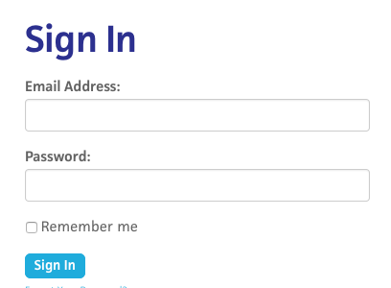
Review HTML Forms
•
HTML Forms are used to get input from the user
www.luv2code.com

Slide 3
Spring MVC Form Tags
•
Spring MVC Form Tags are the building block for a web page
•
Form Tags are configurable and reusable for a web page
www.luv2code.com

Slide 4
Data Binding
•
Spring MVC Form Tags can make use of data binding
•
Automatically setting / retrieving data from a Java object / bean
www.luv2code.com

Slide 5













Spring MVC Form Tags
Form tags will generate HTML for you :-)
Form Tag Description
form:form | main form container
form:input | text field
form:textarea | multi-line text field
form:checkbox | check box
form:radiobutton | radio buttons
form:select | drop down list
more ….
www.luv2code.com

Slide 6
Web Page Structure
•
JSP page with special Spring MVC Form tags
<html>
… regular html …
… Spring MVC form tags …
… more html …
</html>
www.luv2code.com

Slide 7

How To Reference Spring MVC Form Tags
Specify the Spring namespace at beginning of JSP file
<%@ taglib prefix="form" uri="http://www.springframework.org/tags/form" %>
www.luv2code.com

Slide 8
Spring MVC Form Tag - Text Field

Slide 9


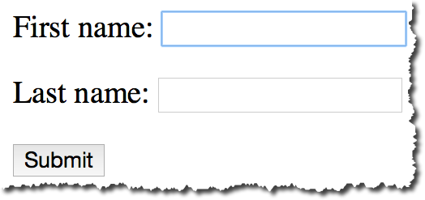


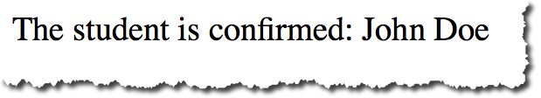
Big Picture
student-form.jsp
Student
Student Controller
Student
student-confirmation.jsp
www.luv2code.com

Slide 10
Showing Form
In your Spring Controller
•
Before you show the form, you must add a model attribute
•
This is a bean that will hold form data for the data binding
www.luv2code.com

Slide 11
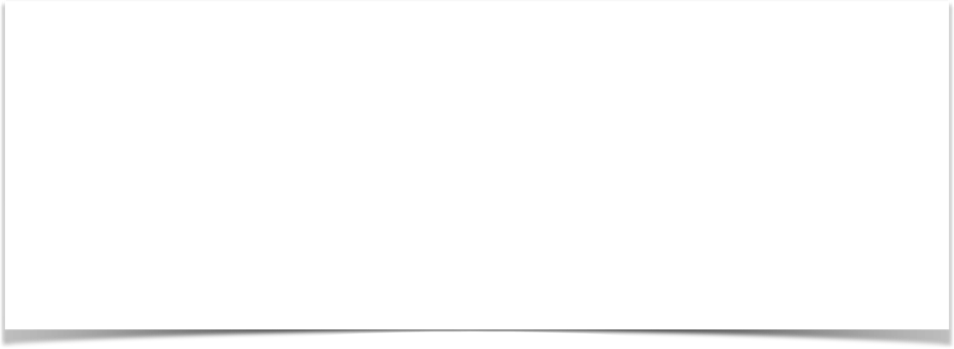
Show Form - Add Model Attribute
Code snippet from Controller
@RequestMapping("/showForm")
public String showForm(Model theModel) {
theModel.addAttribute("student", new Student()); return "student-form";
}
www.luv2code.com

Slide 12
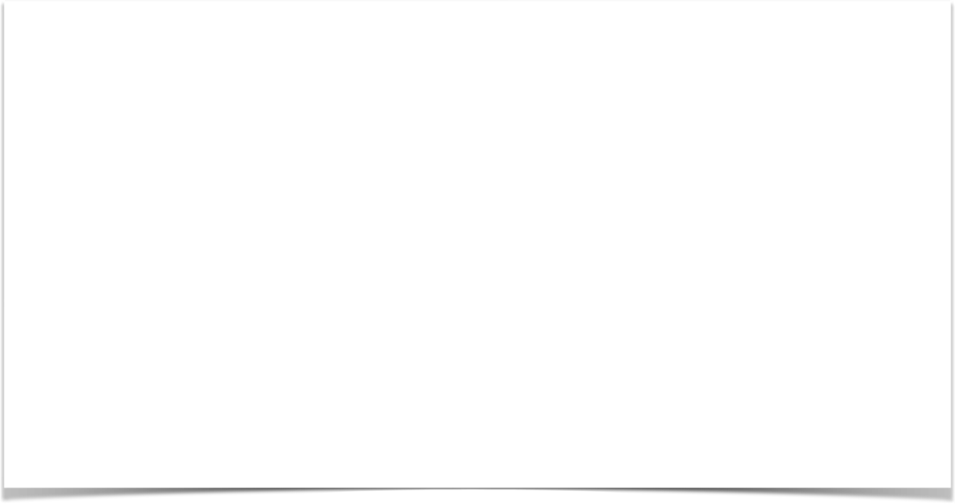

Setting up HTML Form - Data Binding
<form:form action="processForm" modelAttribute="student">
First name: <form:input path="firstName" />
<br><br>
Last name: <form:input path="lastName" />
<br><br>
<input type="submit" value="Submit" />
</form:form>
www.luv2code.com

Slide 13

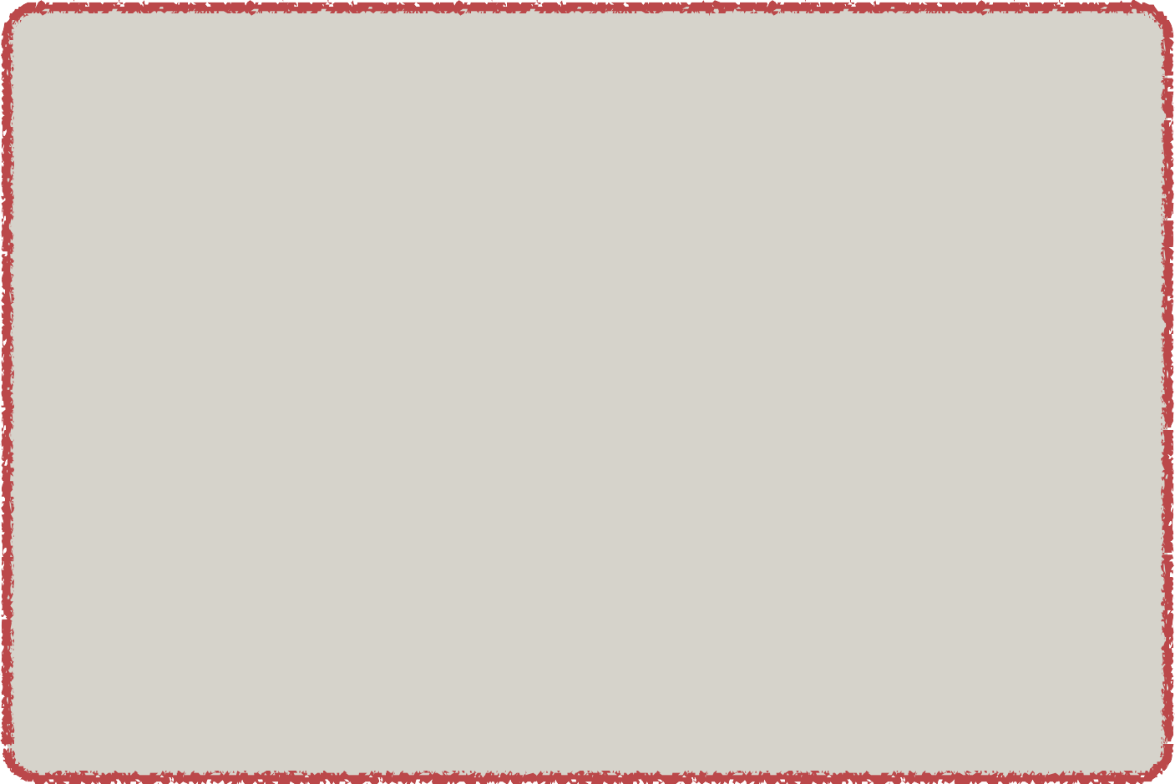
When Form is Loaded … fields are populated
<form:form action="processForm" modelAttribute="student">
First name: <form:input path="firstName" />
When form is loaded, Spring MVC will call:
<br><br>
Last name: <form:input path="lastName" />
student.getFirstName()
…
<br><br>
student.getLastName
<input type="submit" value="Submit" />
</form:form>
www.luv2code.com

Slide 14

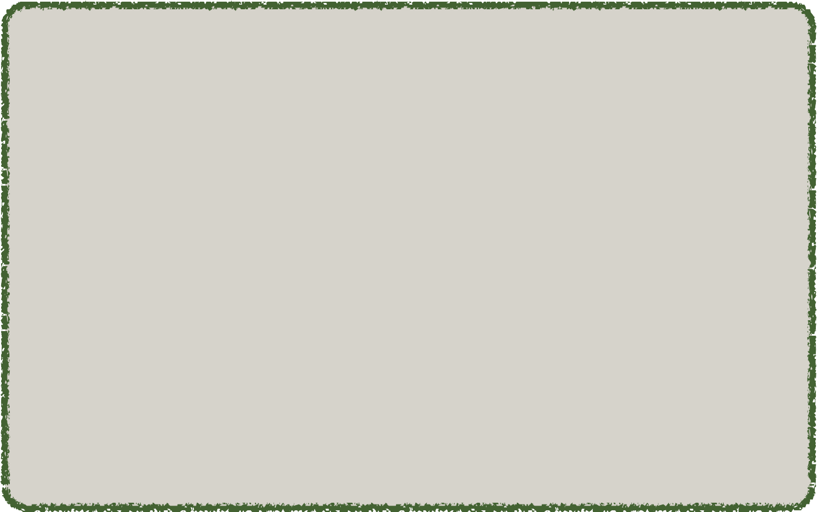
When Form is submitted … calls setter methods
<form:form action="processForm" modelAttribute="student">
First name: <form:input path="firstName" />
When form is submitted, Spring MVC will call:
<br><br>
Last name: <form:input path="lastName" />
student.setFirstName(…)
…
<br><br>
student.setLastName(…)
<input type="submit" value="Submit" />
</form:form>
www.luv2code.com

Slide 15
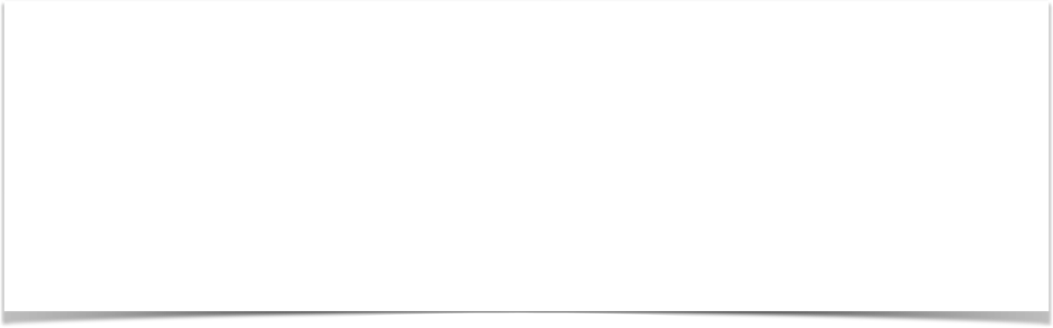
Handling Form Submission in the Controller
Code snippet from Controller
@RequestMapping("/processForm")
public String processForm(@ModelAttribute("student") Student theStudent) {
// log the input data
System.out.println("theStudent: " + theStudent.getFirstName()
+ " " + theStudent.getLastName());
return "student-confirmation";
}
www.luv2code.com

Slide 16
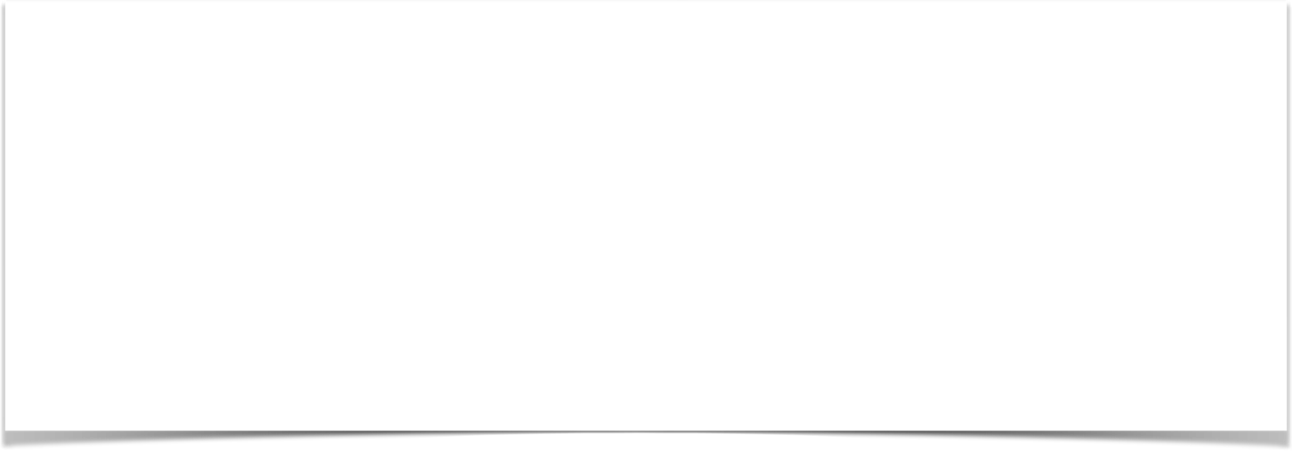

Confirmation page
<html>
<body>
The student is confirmed: ${student.firstName} ${student.lastName}
</body>
</html>
www.luv2code.com

Slide 17
Pulling It All Together
student-form.jsp
Student
Student Controller
Student
student-confirmation.jsp
www.luv2code.com

Slide 18
Development Process
Step-By-Step
Create Student class
Create Student controller class
Create HTML form
Create form processing code
Create confirmation page
www.luv2code.com

Slide 19
Spring MVC Form Tag - Drop Down List

Slide 20
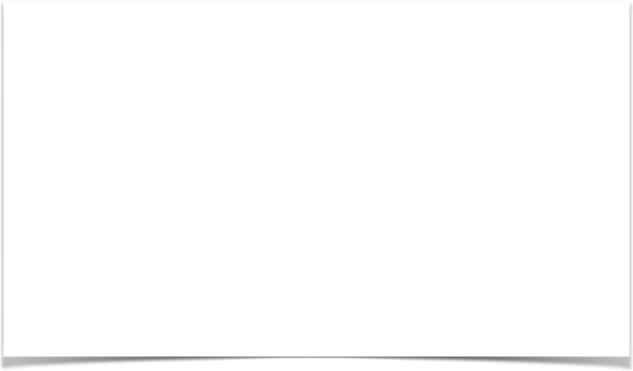

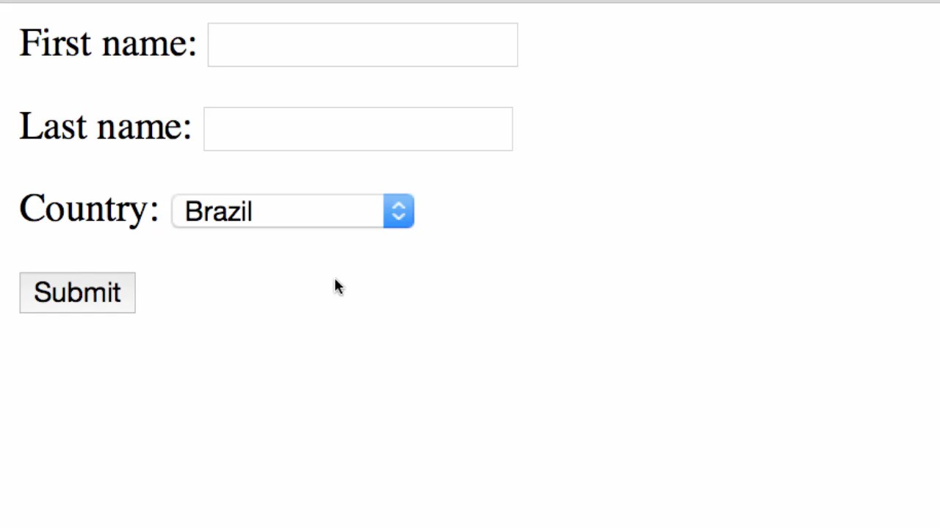
Review of HTML <select> Tag
<select name=“country”>
<option>Brazil</option>
<option>France</option>
<option>Germany</option>
<option>India</option>
...
</select>
www.luv2code.com

Slide 21
Spring MVC Tag
Drop-Down List is represented by the tag
<form:select>
www.luv2code.com

Slide 22

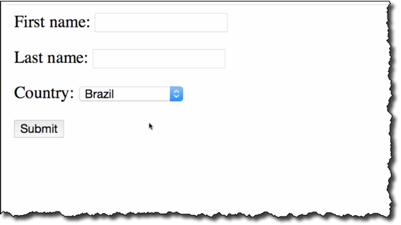
Code Snippet
<form:select path="country">
<form:option value="Brazil" label="Brazil" />
<form:option value="France" label="France" />
<form:option value="Germany" label="Germany" />
<form:option value="India" label="India" />
</form:select>
www.luv2code.com

Slide 23




Pulling It All Together
student-form.jsp
Student
student form
Student Controller
Student
student-confirmation.jsp
confirmation page
www.luv2code.com

Slide 24
Development Process
Step-By-Step
Update HTML form
Update Student class - add getter/setter for new property
Update confirmation page
www.luv2code.com

Slide 25
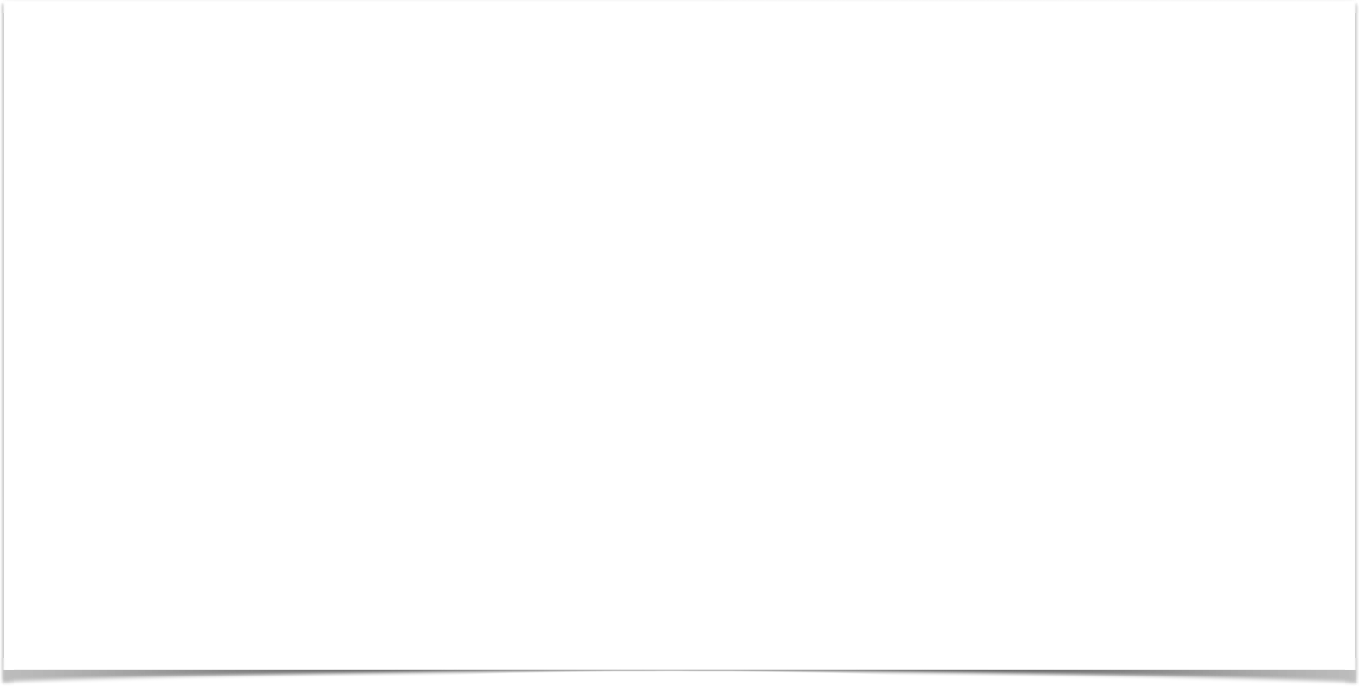

Spring MVC Form Tag - Radio Buttons

Slide 26
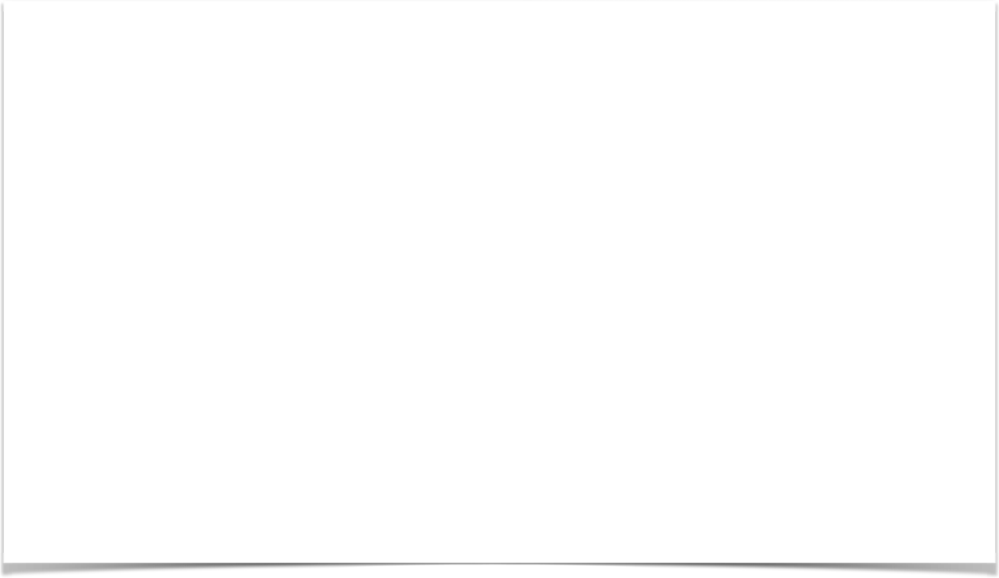
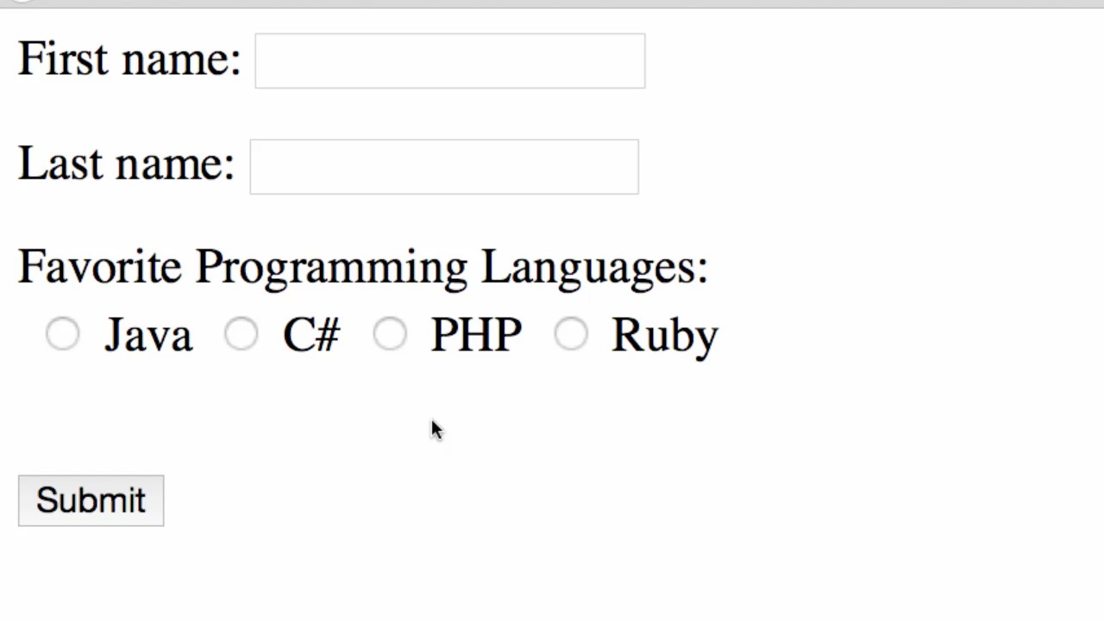
Radio Button Demo
www.luv2code.com

Slide 27
Spring MVC Tag
A Radio Button is represented by the tag
<form:radiobutton>
www.luv2code.com

Slide 28
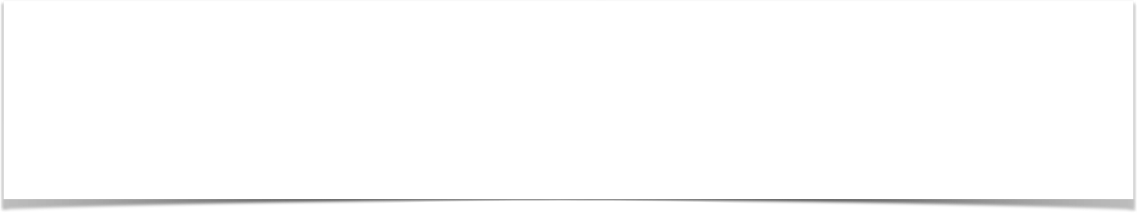
Code Example
Java <form:radiobutton path="favoriteLanguage" value="Java" /> C# <form:radiobutton path="favoriteLanguage" value="C#" /> PHP <form:radiobutton path="favoriteLanguage" value="PHP" />
Ruby <form:radiobutton path="favoriteLanguage" value="Ruby" />
www.luv2code.com

Slide 29
Pulling It All Together
student-form.jsp
Student
student form
Student Controller
Student
student-confirmation.jsp
confirmation page
www.luv2code.com

Slide 30
Development Process
Step-By-Step
Update HTML form
Update Student class - add getter/setter for new property
Update confirmation page
www.luv2code.com

Slide 31
Spring MVC Form Tag - Check Box

Slide 32
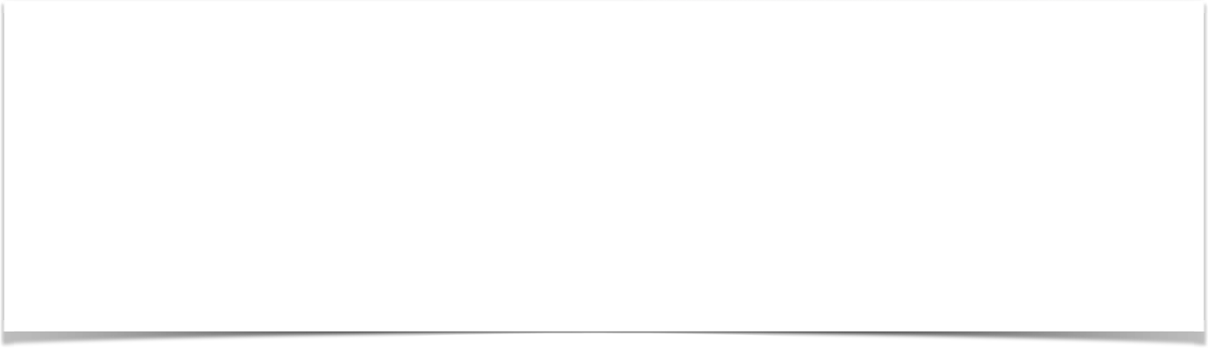
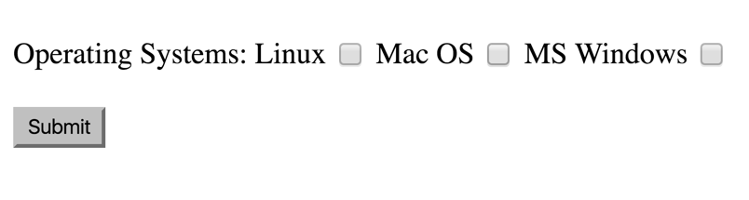
Check Box - Pick Your Favorite OS
www.luv2code.com

Slide 33
Spring MVC Tag
A Check Box is represented by the tag
<form:checkbox>
www.luv2code.com

Slide 34
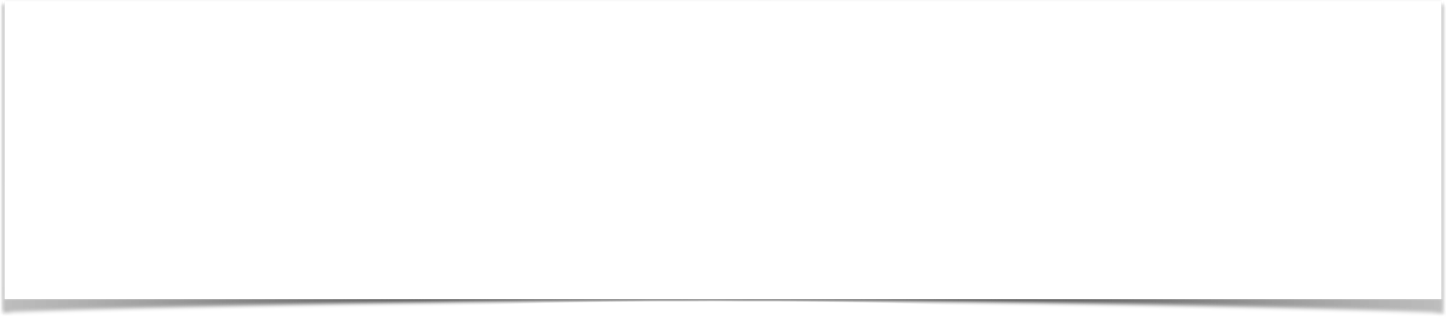
Code Example
Linux <form:checkbox path="operatingSystems" value="Linux" /> Mac OS <form:checkbox path="operatingSystems" value="Mac OS" /> MS Windows <form:checkbox path="operatingSystems"
value="MS Windows" />
www.luv2code.com

Slide 35
Pulling It All Together
student-form.jsp
Student
student form
Student Controller
Student
student-confirmation.jsp
confirmation page
www.luv2code.com

Slide 36
Development Process
Step-By-Step
Update HTML form
Update Student class - add getter/setter for new property
Update confirmation page
www.luv2code.com

